Slide 1
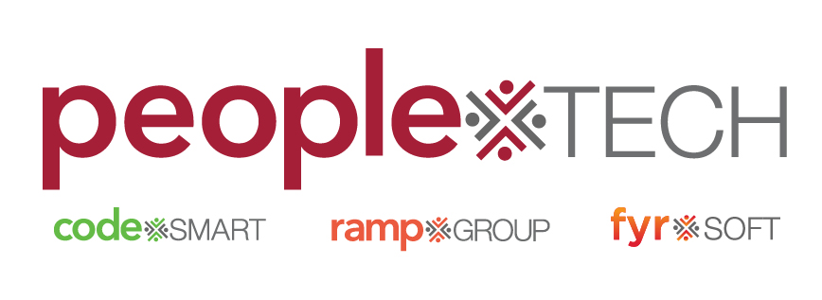

Slide 2
Context
Understand different SDLC models and their importance in project development.

Slide 3
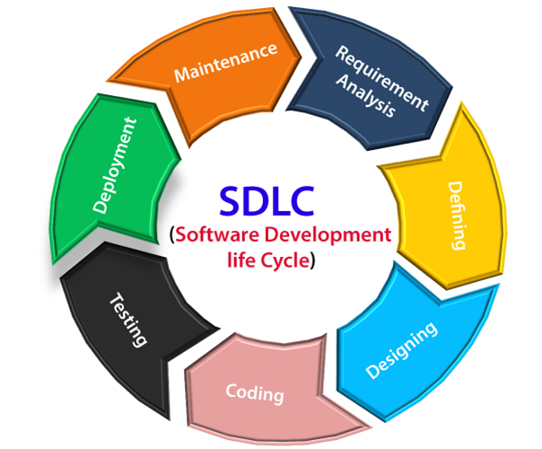
What is software development life cycle
The Software Development Life Cycle (SDLC) is a systematic process used to develop software applications, encompassing a series of well-defined phases. These phases include planning, requirements gathering, design, implementation, testing, deployment, and maintenance. The SDLC aims to produce high-quality software that meets or exceeds customer expectations while being delivered on time and within budget.
In SDLC serval's step by step process
1.Requirement's Gathering
2.Blue_print /planning
3.Design 4.Development
5.Testing
6.Deployment
7.Maintenace

Slide 4

1.Requirements Analysis
Gathering and analyzing business requirements to understand what the software should accomplish.
The requirement includes how
the product will be used and
who will use the product to determine
the load of operations. All information
gathered from this phase is critical to
Developing the product as per the customer requirements.

Slide 5

2 Blueprint/planning
The planning phase typically includes tasks like cost-benefit analysis, scheduling, resource estimation, and allocation. The development team collects requirements from several stakeholders such as customers, internal and external experts, and managers to create a software requirement specification document.

Slide 6

3.Design
In the design phase, software engineers analyze requirements and identify the best solutions to create the software.
For example, they may consider integrating pre-existing modules, make technology choices, and identify development tools. They will look at how to best integrate the new software into any existing IT infrastructure the organization may have.
Design is two type in SDLC.
1.Low level Design 2.High level Design

Slide 7

4.Development/Coding
In the development/coding phase, the development team codes the product. They analyze the requirements to identify smaller coding tasks they can do daily to achieve the final result.

Slide 8
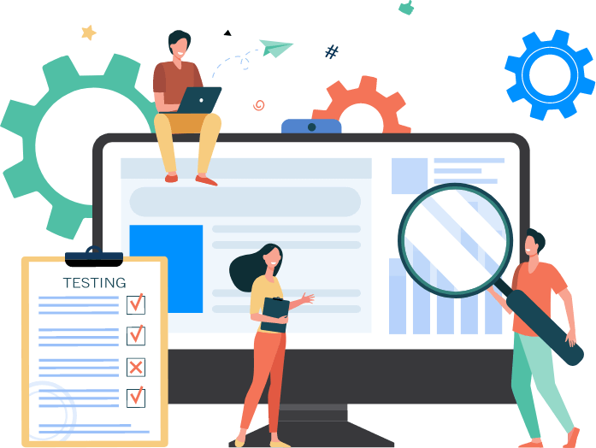
5.Testing
The development team combines automation and manual testing to check the software for bugs.
Quality analysis includes testing the software for errors and checking if it meets customer requirements. Because many teams immediately test the code they write, the testing phase often runs parallel to the development phase.

Slide 9

6.Deployment
When teams develop software, they code and test on a different copy of the software than the one that the users have access to. The software that customers use is called production, while other copies are said to be in the build environment, or testing environment.
Having separate build and production environments ensures that customers can continue to use the software even while it is being changed or upgraded.

Slide 10
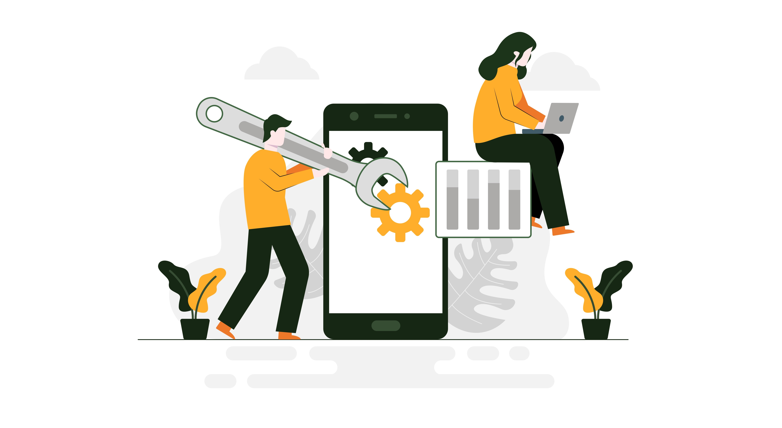
7.Maintance
In the maintenance phase, among other tasks, the team fixes bugs, resolves customer issues, and manages software changes. In addition, the team monitors overall system performance, security, and user experience to identify new ways to improve the existing software

Slide 11
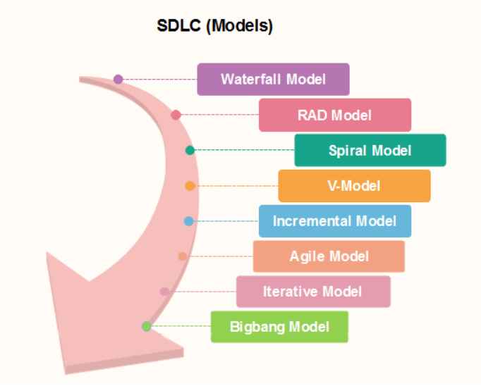
software development life cycle model's
Software Development life cycle (SDLC) is a structured model used in project management that defines the stages include in an information system development project, from an initial feasibility study to the maintenance of the completed application.
There are different software development life cycle models specify and design, which are followed during the software development phase. These models are also called "Software Development Process Models."
In software models are so many types:-
1.waterfall model
2.V-model
3.Incremental model
4.RAD(Rapid Application development)
5.Spiral model
6.Prototype model
7.iterative model
8.Agile model

Slide 12
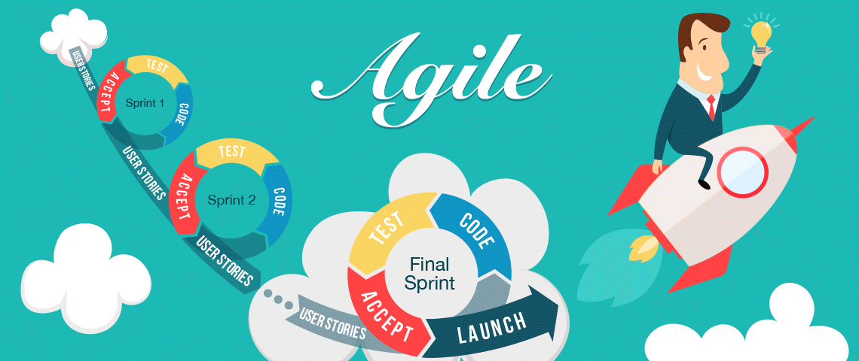
1.Agile Model
The meaning of Agile is swift or versatile. " Agile process model" refers to a software development approach based on iterative development. Agile methods break tasks into smaller iterations, or parts do not directly involve long term planning. The project scope and requirements are laid down at the beginning of the development process. Plans regarding the number of iterations, the duration and the scope of each iteration are clearly defined in advance.
Advantages:-
Frequent Delivery
Face-to-Face Communication with clients.
Efficient design and fulfils the business requirement.
Anytime changes are acceptable.
It reduces total development time.
Disadvantages:-
Due to the shortage of formal documents, it creates
confusion and crucial decisions taken throughout various
phases can be misinterpreted at any time by different team members

Slide 13
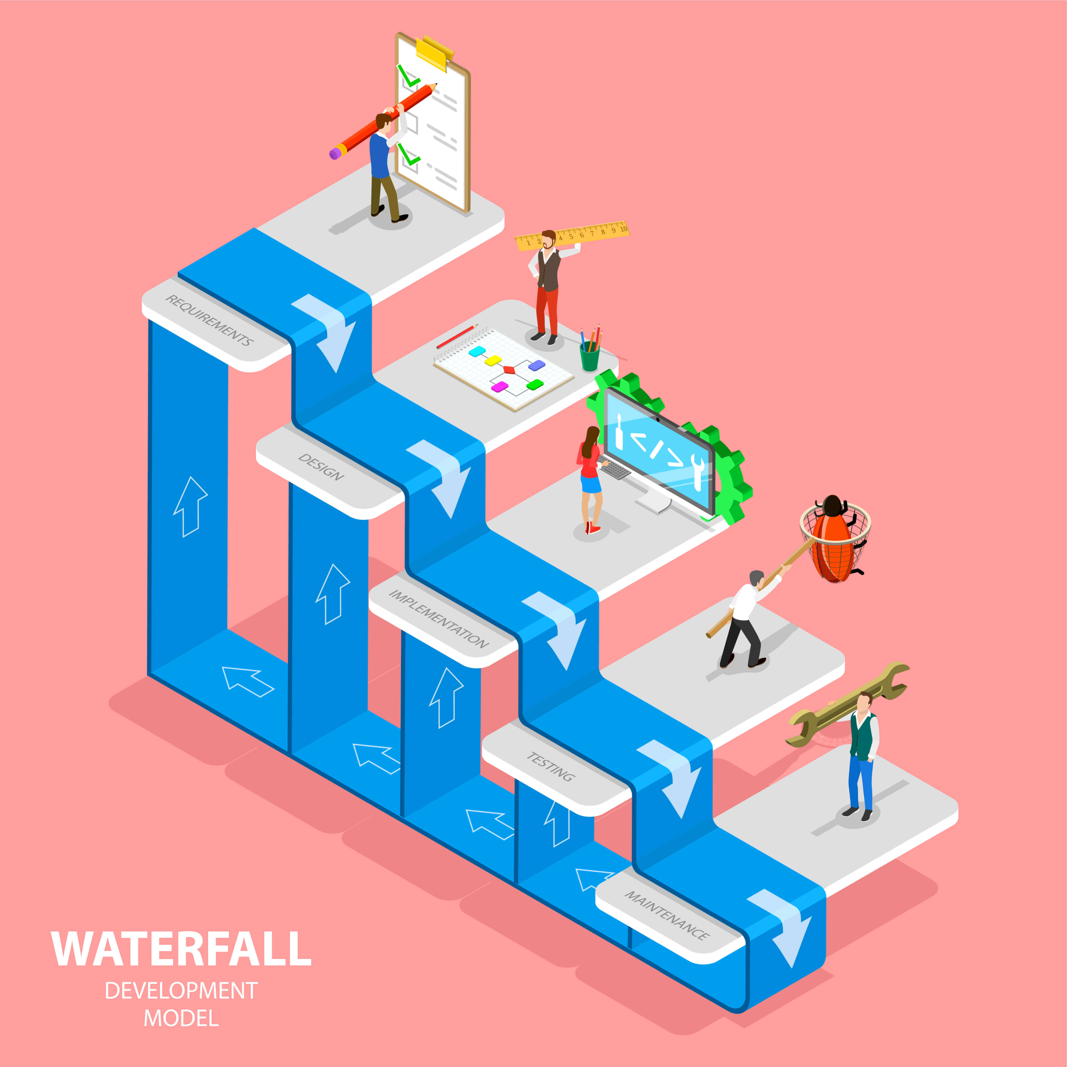
2.Waterfall model
The waterfall model is a continuous software development model in which development is seen as flowing steadily downwards (like a waterfall) through the steps of requirements analysis, design, implementation, testing (validation), integration, and maintenance.
Ex:-Imagine creating an e-commerce website with the waterfall model. First, detailed requirements are gathered, and then the design phase creates the layout and database structures. Developers then code the backend and frontend. After that, the site is rigorously tested in the verification phase. Finally, it goes live and enters maintenance, where updates and bug fixes happen. This method ensures each phase is completed before moving to the next, but it’s not flexible for changes mid-project.

Slide 14
3.Scrum Model
Scrum is a way to manage software projects in small steps. Work is divided into short time periods called sprints (1–4 weeks). Each sprint, the team builds and tests part of the software.
Scrum Team Roles:
Product Owner – decides what to build
Scrum Master – makes sure the process runs smoothly
Team Members – build and test the software

